Slide 1
Working with data scientist
Luther Hill
Notes:
Three types of Data Scientist
Data Practitioner
Data Researcher
Data Analyst

Slide 2
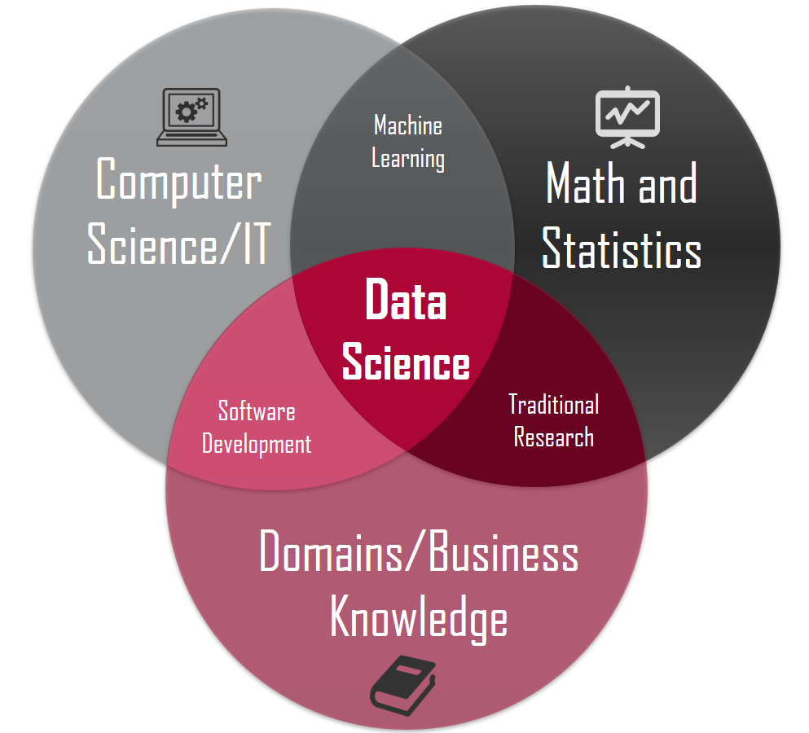

Slide 3
Data practitioner
Machine learning engineer
Focuses on end result
Part coder part researcher
What metrics do you need tracked.
Works on production models
Integrates with rest of the team
Tinkers with ideas
Specializes

Slide 4
Data researcher
Academic
PHD
Not production ready
Focused on publishing
Improving public results
Python
Cutting edge
R (Data Pirate)

Slide 5
Data analyst
Analytics
Python
Backward looking
Domain expert
Business processes
Minimal data engineering
SQL
Pre-packaged

Slide 6
Questions

